Slide 1
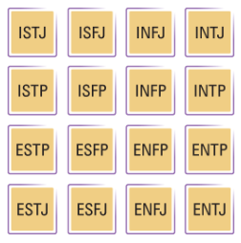
PROJECT – 4
Personality classification
Background :
The Myers Briggs Type Indicator (or MBTI for short) is a personality type system that divides everyone into 16 distinct personality types across 4 axis:
Introversion (I) – Extroversion (E)
Intuition (N) – Sensing (S)
Thinking (T) – Feeling (F)
Judging (J) – Perceiving (P)
Fig ref: https://www.myersbriggs.org/my-mbti-personality-type/mbti-basics/home.htm?bhcp=1\
Problem statement: The objective of this model to conduct exploratory data analysis and basic text analytics Based on Word Clouds from the given dataset.
Dataset: mbti1_csv
https://www.kaggle.com/datasnaek/mbti-type

